Slide 1
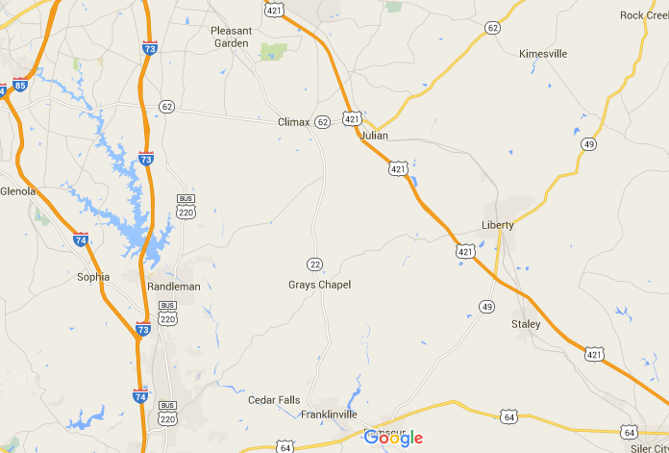
Location

Slide 2
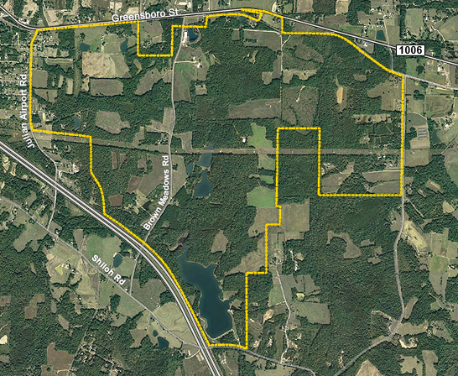
Greensboro St
Old Liberty
Rt 421
Small
Creek
Browns
Meadow Rd
Troy
Smith Rd
Dodson
Lake
Sandy
Creek

Slide 3
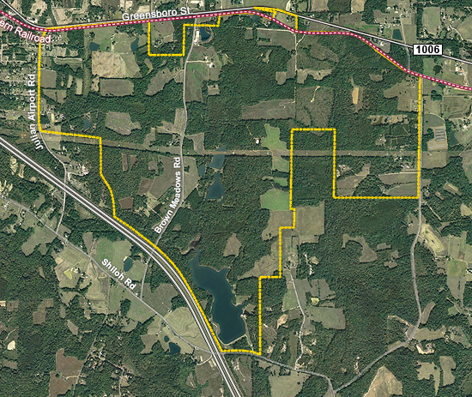
Railroad Line

Slide 4
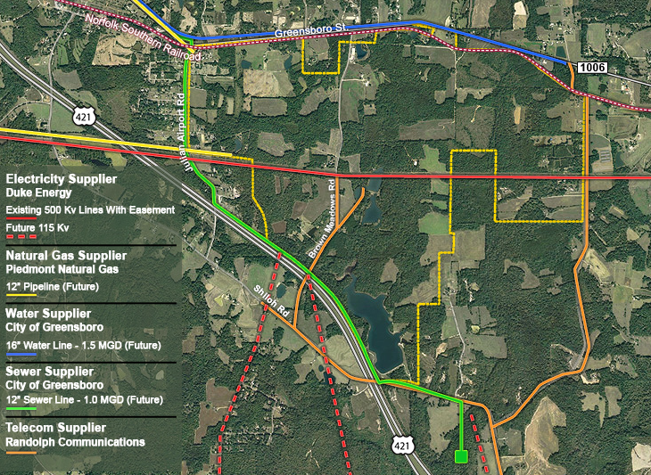

Slide 5
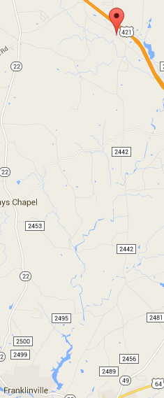
Megasite
Sandy
River
Deep River
Ramseur Lake

Slide 6
Greensboro/Randolph Megasite Foundation
Non profit organization
Primary mission to assemble a tract of land in RC
Promote extension of water and sewer services
Develop site so that it will be usable by advanced manufacturer
To seek funding to acquire properties and aid development and marketing
Lessen the burden on local governments for marketing the site
Promote Randolph and Greensboro as areas for advanced manufacturing facility
Board of Directors
Greensboro City Council representative Jim Westmoreland, City Mgr
Randolph County Commissioner representative – Hal Johnson, Cty Mgr
3 representatives from Bryan Foundation
E. S. ‘Jim’ Melvin
10 yr mayor of Greensboro
Banker
Dev of Newbridge Ball Park and Elon Law
Carole W. Bruce
Lawyer - estates, taxes, trusts
J. Edward Kitchen
UNC Pres School of government

Slide 7
McCallum Sweeney Consulting criteria, specializes in certifying megasites G-R will use KPMG
Start of concept
Determine the industry first
commitment of the owner and local government to move quickly on a very large project,
Certification
clear ownership title
size and configuration of the site
utility availability
transportation availability
favorable environmental assessment
engineering studies
delineation of wetlands
topography data and maps
quoted price

Slide 8
Certification
clear ownership title – most of the land already purchased
size and configuration of the site
utility availability
The foundation is paying for Duke Energy to study how to bring power to the site and which route to use, a process the power company won't fund itself without a client ready to use the site
transportation availability
interchange planning — which is typically funded by the state when an end user is already in place — can move ahead because the foundation paying for the work - Zapata-LJB, a preconstruction firm based in Charlotte, to conduct the environmental impact study for the interchange design
favorable environmental assessment – initial studies done
engineering studies – initial studies done
delineation of wetlands – initial studies done
topography data and maps – initial studies done
quoted price

Slide 9
Carolina Journal April 6, 2016
The 1,400-acre Greensboro-Randolph Megasite appears to be several years away from being a suitable location for the automotive plant or other large manufacturing facility it was designed to attract
Duke Energy has not begun a study determining how to provide power to the site
North Carolina Railroad Company does not have enough money to buy land needed for the location
two newly elected members of the Randolph County Board of Commissioners are skeptical of the endeavor

Slide 10
Greensboro Randolph Megasite Accreditation Process
Wetlands-The unnamed tributaries on the project site drains to Dobson Lake and later into Sandy Creek.
According to the NCDENR-DWR, Sandy Creek is classified as WS-III and is not listed on the most recent 303(d) list
of impaired waters. Therefore, state mandated buffers are not required along streams.
Randolph County (or portions of Randolph County) may also be subject to local Randleman Watershed requirements.
ECS recommends consultation with a county civil engineer to determine if mandatory vegetative buffers
and/or regulated development (impervious surfaces) setbacks are required adjacent to surface waters as a
result of local storm water requirements. Additional Considerations The site is located in the Sandy Creek
Watershed, which is part of the Cape Fear River Basin. There are no state mandated buffer rules in effect for
this watershed at this time. ECS recommends that erosion control measures and best management practices are
installed and implemented on-site prior to earth moving activities.

Slide 11
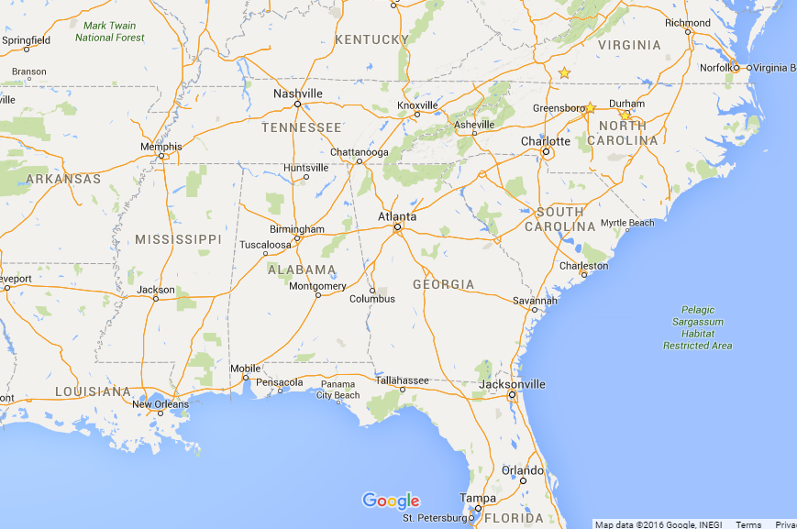
Ten megasites in the South for the next 'Big Kahuna‘ - 2012

Slide 12
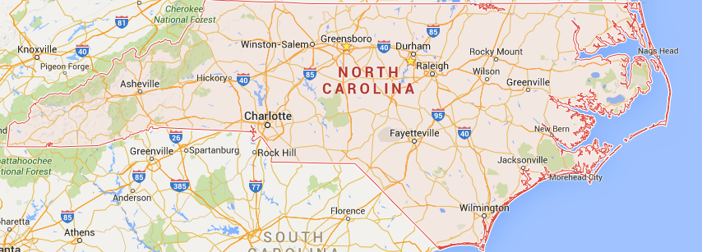
North Carolina Sites January 2013
5915
1688
3943
5915
1700
1300
1500
1200
1818
1307
1500
1315
1500
1130
1000
1161
2000
Further NC Sites as of 2015
1818

Slide 13
Current megasites Feb 2013
North Catrolina
Moore County - The Heart of North Carolina Megasite
Triangle North Warren is an 860-acre megasite located the northern part of the Research Triangle Region of North Carolina just 3 miles from Interstate 85. Triangle North Granville is a life sciences and technology 527-acre park in Granville County located in the northern part of the Research Triangle Region of North Carolina. Triangle North Vance is a 422-acre business and manufacturing park located near Interstate 85 at exit 209, across from Vance-Granville Community College in the northern part of the Research Triangle Region of North Carolina. All the Triangle North parks offer $12,500 per job state tax credit for companies that locate in the park plus all the other perks that go with locating in the original Research Triangle Park (RTP) built in the 1950s. GIPH Site, 1700 Acres, Hertford County Tanglewood, 5,915 Acres, Pasquotank County Verona Site, 3,943 Acres, Northampton County The North Carolina Global TransPark (GTP) is a 2,500 acre, multi-modal industrial park offering unparalleled access to air, rail, highways, and North Carolina's two international ports. Hearts Delight near Aulander 1900 acres. Riverstone Business Park, Forest City 1000 acres Pine Hills Ind. Hamlet 1500 acres Laurinburg-Maxton Airport Industrial Park 2000 acres Former Army Air Core Base Training Facility, This one made sense. Great Meadows Morganton 1200 acres Newton Grove 1161 acres Mid-Atlantic Business Ct Rocky Mount 1,668 acres Kingsboro Rose, Rocky Mount 1300 acres Norwood Tract, Saratoga 1315 acres Monroe site, Southern Pines 1130 acres Mid Atlantic Logistics Center in Brunswick County 1000 acres Leland Industrial Park in Brunswick County 2200 acres International Logistics Park of North Carolina in Brunswick County 1000 acres

Slide 14
January 2013
Aulander Hearts Delight site 1,900 Northeast NC; Norfolk Va. Rail line Tiffany McNeill, NC Dept. Commerce, (919) 733-4977, tmcneill@nccommerce.com
Elizabeth City Tanglewood Megasite 5,915 former ag site now zoned industrial on 4-lane U.S. Hwy. 17; rail. Tiffany McNeill, NC Dept. Commerce, (919) 733-4977, tmcneill@nccommerce.com
Forest City Riverstone Business Park 1,000 former tree farm midway between Asheville and Charlotte; sale, Tiffany McNeill, NC Dept. build-to-suit or lease; all utilities; rail; Commerce, (919) 733-4977, tmcneill@nccommerce.com
Hamlet Pine Hills Ind. Park 1,500 Open land now zoned heavy industrial; between Rockingham and Tiffany McNeill, NC Dept. Southern Hills; rail. Commerce, (919) 733-4977, tmcneill@nccommerce.com
Jackson Verona Plantation 3,943 ag/residential zoning; near Va. state line & Norfolk airport; rail. Tiffany McNeill, NC Dept. Commerce, (919) 733-4977, tmcneill@nccommerce.com
Laurinburg Laurinburg-Maxton 2,000 Former Army Air Core Base Training Facility, now zoned heavy Tiffany McNeill, NC Dept. Airport Industrial Park industrial; near SC state line; rail. Commerce, (919) 733-4977, tmcneill@nccommerce.com
Morganton Great Meadows 1,200 straddles I-40; all utilities; no rail. Tiffany McNeill, NC Dept. Commerce, (919) 733-4977, tmcneill@nccommerce.com SUPER SITES State Nearest City or Cnty Site Name Acreage Notes Contact 1301SuperSites2.indd 58 1/14/13 1:22 PM SITE SELECTION JANUARY 2013 N. Carolina
Newton Grove I-40 Exit 348 Site 1,161 East of I-95; all utilities; no rail. Tiffany McNeill, NC Dept. (cont.) Commerce, (919) 733-4977, tmcneill@nccommerce.com
Rocky Mount Mid-Atlantic Business Ctr. 1,688 10 mi. to I-95; all utilities; plans to extend CSX rail spur; zoned Oppie N. Jordan, Carolinas ag/residential; $18K/acre, all acreage under option Gateway Partnership, (252) 442- 0114, ojordan@econdev.org
Kingsboro Rose 1,307 Former ag site now zoned M-3 Industrial; adjacent to US 64, Tiffany McNeill, NC Dept. 5 mi. east of Rocky Mount; all utilities on site; CSX rail; Commerce, (919) 733-4977, Environmental and geotechnical studies completed. tmcneill@nccommerce.com
Saratoga Norwood Tract 1,315 forested site just off Hwy. 264 bypass Tiffany McNeill (see above)
Southern Pines Monroe site 1,130 Near Pinehurst; undeveloped; RA-5 zoning; Tiffany McNeill (see above)
Winton Hertford Co. GIPH site 1,700 Idled site, zoned heavy industrial; all utilities in place; near Tiffany McNeill (see above)
South Carolia
Aiken Sage Mill East Ind. Park 1,340 utilities in place; 4 mi. to I-20; NS rail; half timber cleared S.C. Dept. Commerce (803) 737-0400
Bowman Whetsell 1,239 on I-26 Gregg Robinson (803) 536-3333
Dillon I-95 Gateway Industrial Park 1,400 gas, power, sewer and water, pluus 1-million-gallon water tank Fred Gassaway 803-254-9211 on site; 28 mi. to Florence, 30 mi. to I-20
Carolinas I-95 Megasite 1,920 Certifi ed as megasite in Aug. 2010 based on study by Wilbur Smith Fred Gassaway 803-254-9211 Associates; gas, power, sewer and water, incl. 1-million-gallon www.scpowerteam.com water tank; state line location with N.C., equidistant to ports of Charleston and Wilmington.
Florence White Hawk Commerce Park 1,175 Cerfi fi ed megasite by McCallum Sweeney; CSX dual mainlines, Daryl Corbin (843) 413-9427 with spur approved; near I-95 & I-20, across road from Florence whitehawkllc@gmail.com Regional Airport; all utilities; single owner; no zoning required
Greenville Matrix Business Park 1,100 I-2 zoning; corner of US-25 and I-185, within 4 miles of I-85. South Kevin Landmesser (864) 235-2008 Carolina Certifi ed Site as of June 2010; Current tenants include klandmesser@greenvillecounty. GE Aviation, JTEKT, Gordon Food Serv. and The Blood Connection. org, www.thematrixpark.com
Lancaster Lansford (Foster Crossroads) 3,395 site under development Keith Tunnell (803) 726-8127
Richburg L&C Tract A 1,151 1 mi. from I-77 Rick Moorefi eld (803) 377-1216
Timmonsville Young Lands 1,422 near Florence; 3 mi. to I-95, 9 mi. to I-20; no rail Kyle Edney (843) 676-8796
Sumter I-95 Megasite 1,400 on I-95 with over 2 miles of frontage, not 2 miles away from I-95. John Truluck (803) 435-8813 Rail and gas are both planned and within a reasonable distance.

Slide 15
Economic impact
industry experts predict three to five new Auto OEM sites over the next two to five years in North America
Automobile plant for Randolph County
2000 jobs
Jefferson County, TN, mega site projects that over 30 years it would yield $11 in local tax revenue for every $1 the public invested to develop the site
Cost of land and bringing utilities to edge of property - $52 million, est. by G-R foundation
Displaced landowners
Cost of certification $50,000 to $2,000,000 or more
Tax incentives – state and local $400 million estimate for Randolph site
Total education budget $8.6 billion
Of the three TN sites, two are behind schedule

Slide 16
Southern Business & Development magazine expects between five to ten new assembly plants to be built in North America in the next four years and claims the Piedmont Triad region as their number one spot in the southern auto corridor that they believe can support a new assembly plant based on labor availability and quality and the area’s history. D

Slide 17
Triad business Journal
The Greensboro-Randolph Megasite is anticipating site certification in late April or… more
The letter, penned by N.C. Railroad Co. President Scott Saylor to the county commission, explains that the railroad has set aside $13 million to complete the purchase of 875 acres within the 1,550-acre megasite footprint, and will close on a majority of that acreage within two weeks. The remainder will be purchased "within the few months that follow," the letter says.
That should quell any talk by opponents of the site that the N.C. Railroad, whichannounced plans to buy the chunk of land from the megasite foundation in January, didn't have the dollars to follow through on the deal, Melvin said.
That's key as the site moves toward being certified by the state and by KPMG either late this month or in early May, and has an agreement recently inked between the foundation, Randolph County (which has a deed for $10 million of acreage in the site) and the railroad to work hand-in-hand to promote the site, Melvin said.
"We have not tried to market the site until we thought we're ready," Melvin said. "Now we're going to start marketing the site to the world."
These other pieces that are falling into the place — the power and interchange work — help make the site capable of being ready for use within 18 months, once the right large-scale manufacturer is found, he said.
The foundation is paying for Duke Energy to study how to bring power to the site and which route to use, a process the power company won't fund itself without a client ready to use the site, Melvin said.
Likewise, interchange planning — which is typically funded by the state when an end user is already in place — can move ahead because the foundation paying for the work, he said.
"The DOT cannot spend any public money for speculative purposes," Melvin said.
He said the goal is "to have the site ready so that everything that is needed for it can be delivered within 18 months. We're not going to build an interchange until we have a customer."
So does that mean that companies are now shopping around for megasites? Does Melvin know of an automaker who is now ready to kick the tires of a potential home for a new U.S. auto plant?
If Melvin knows of one, he's not saying. But as supporters have always argued, the site needs to be ready to go when one does come knocking, hence the flurry of activity.
"We're confident that it's such a good site that we will eventually get a customer," Melvin said.

Slide 18
April 2016 status by N&R http://www.greensboro.com/news/local_news/power-interchange-plans-being-developed-for-greensboro-randolph-megasite/article_62d767e4-422a-569e-ad4a-2a8f4e45978c.html

